Slide 1
CSG2H3 Object Oriented Programming
JDBC

Slide 2
Java Database Connectivity
An API that lets you access virtually any tabular data source from the Java programming language
an interface which allows Java code to execute SQL statements inside relational databases
the databases must follow the ANSI SQL-2 standard

Slide 3
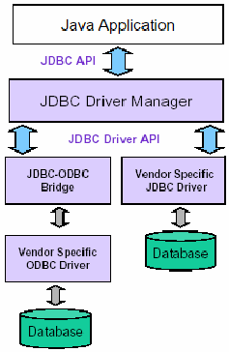
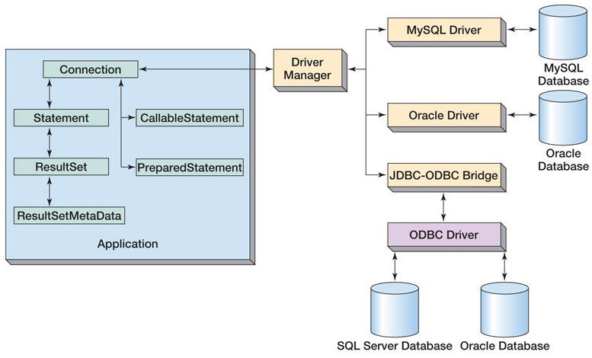
General Architecture

Slide 4
Database Programming Steps
Establish a connection
Begin transaction
Create a statement object
Associate SQL with the statement object
Provide values for statement parameters
Execute the statement object
Process the results
End transaction
Release resources

Slide 5
Using JDBC
Load the driver:
The driver class libraries need to be in the CLASSPATH for the Java compiler and for the Java virtual machine.
The most reliable way to load the driver into the program is:
Class.forName(string).newInstance();

Slide 6
Using JDBC
Establish a connection to the database:
A connection URL string includes the literal jdbc:, followed by the name of the driver and a URL to the database
String url =
"jdbc:oracle:thin:@reddwarf.cs.rit.edu:1521:csodb";
Create a Connection object:
Connection con = DriverManager.getConnection(url, dbUser, dbPassword

Slide 7
Using JDBC
Begin the transaction
con.setTransactionIsolation(connection.TRANSACTION_SERIALIZABLE );
con.setAutoCommit( false );
Create a statement object
Statement stmt = conn.createStatement();
Associate SQL with the statement object
String queryString = "create table students " + "(name varchar(30), id int, phone char(9))";

Slide 8
Using JDBC
Process the statement:
Example statements:
ResultSet rs = stmt.executeQuery(querystring);
int result = stmt.executeUpdate(updatestring);
ResultSetMetaData rsMeta = rs.getMetaData();
Compiled queries can be processed via a PreparedStatement object
Stored procedures can be processed via a CallableStatement object

Slide 9
Using JDBC
End transaction
con.commit();
con.rollback();
Release resources
con.close();

Slide 10
Question?

Slide 11
CSG2H3 Object Oriented Programming
Hibernate ORM

Slide 12
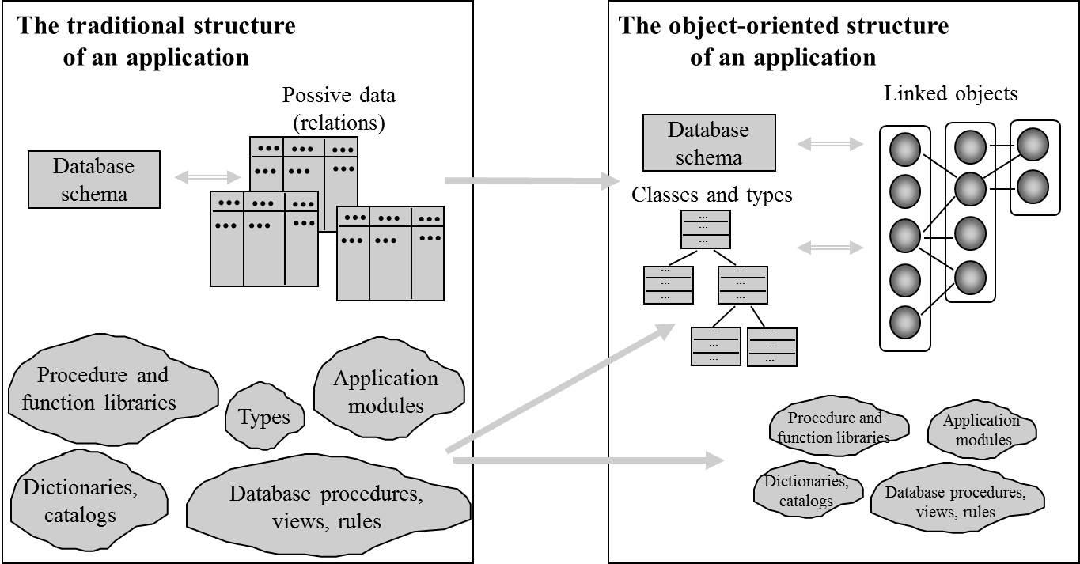
Traditional vs object-oriented application

Slide 13
RDBMS vs OODBMS
Relational databases store data in tables that are two dimensional.
The tables have rows and columns.
Relational database tables are "normalized"
data is not repeated more often than necessary.
All table columns depend on a primary key (a unique value in the column) to identify the column.
Once the specific column is identified, data from one or more rows associated with that column may be obtained or changed.

Slide 14

Hibernate ORM
an object-relational mapping framework for the Java language, providing a framework for mapping an object-oriented domain model to a traditional relational database.
Hibernate solves object-relational impedance mismatch problems by replacing direct persistence-related database accesses with high-level object handling functions.

Slide 15
Simple Tutorial Hibernate ORM
In this example we use :
NetBeans IDE 8.0.1
Java 1.8
Hibernate 4.3
MySQL

Slide 16
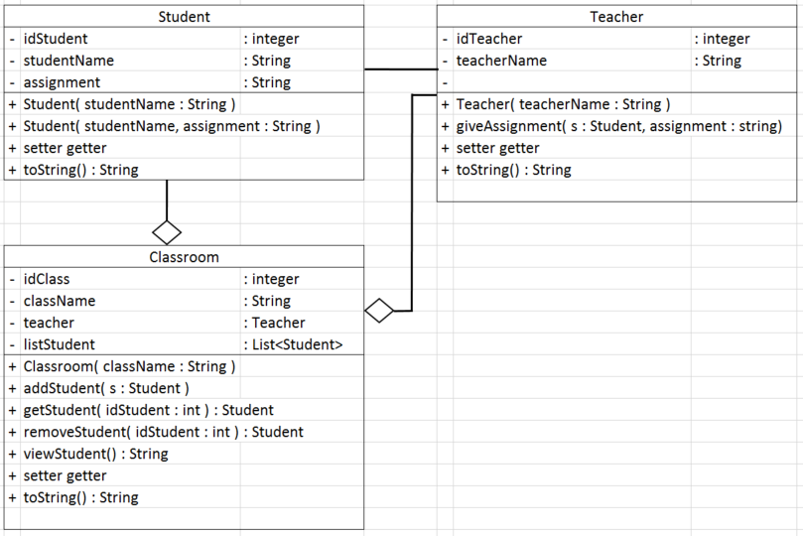
Class Model

Slide 17
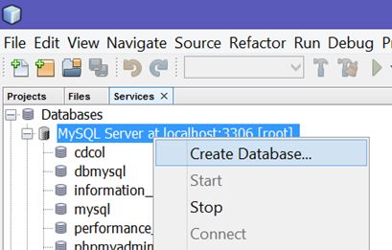
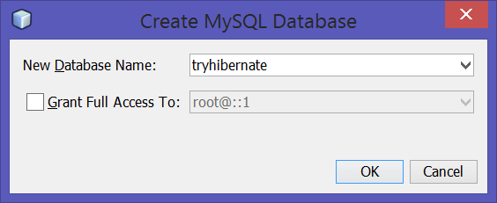
1. Create Database
1
Open services tab
Right-click at MySQL Server
Create Database
Name the database
Click ok
2
3
4

Slide 18
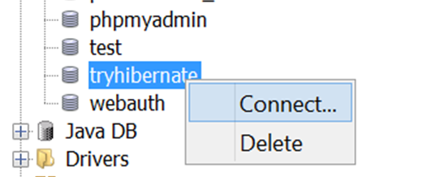
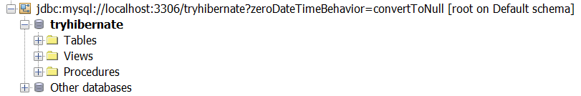
2. Connect to the Database
Right-click at database
click Connect
Look at the connection created

Slide 19
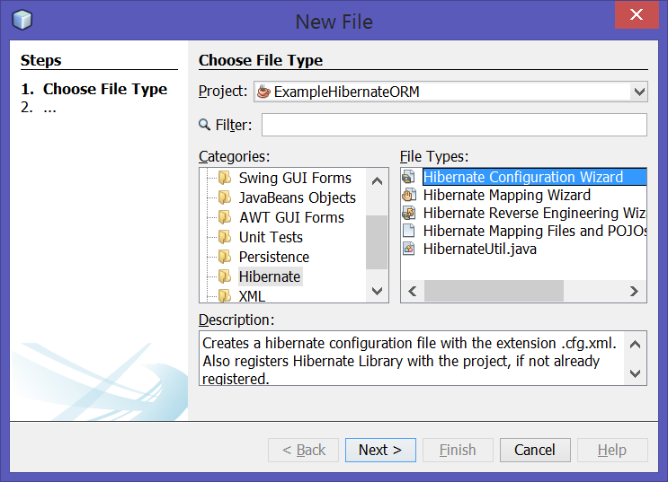
3. Create Hibernate Configuration
3
File -> New File
Select categories : Hibernate
Select Hibernate Configuration Wizard
Next
2

Slide 20
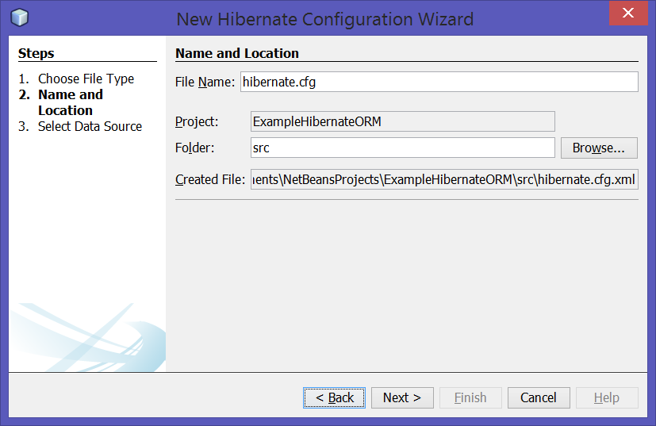
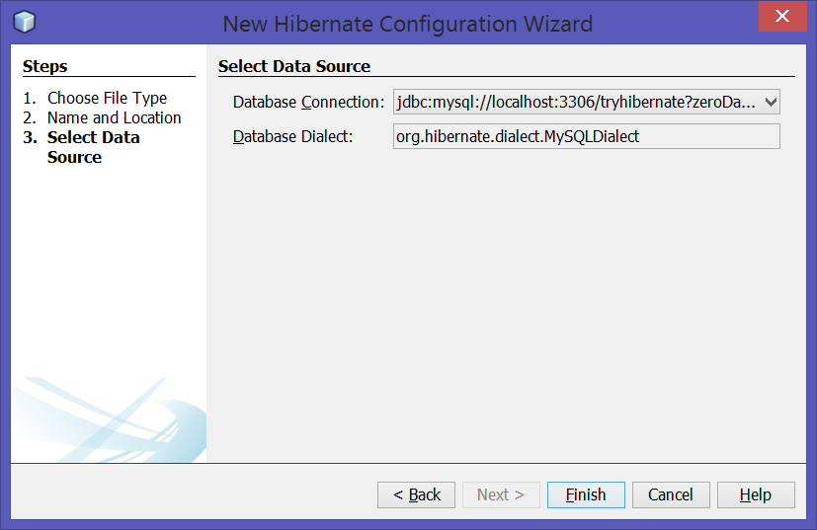
3. Create Hibernate Configuration
5
Don’t change the name and location
Click Next
Select the database connection
Finish
6

Slide 21
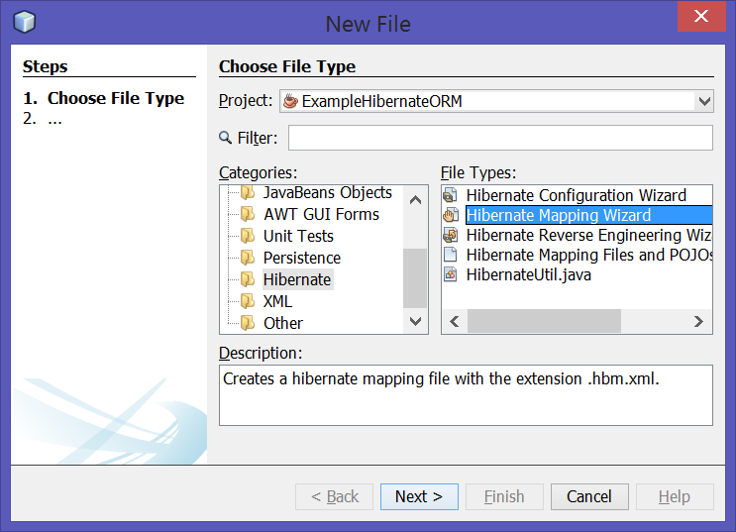
4. Create Hibernate Mapping
File -> New File
Select categories : Hibernate
Select Hibernate Mapping Wizard
Next
3
2

Slide 22
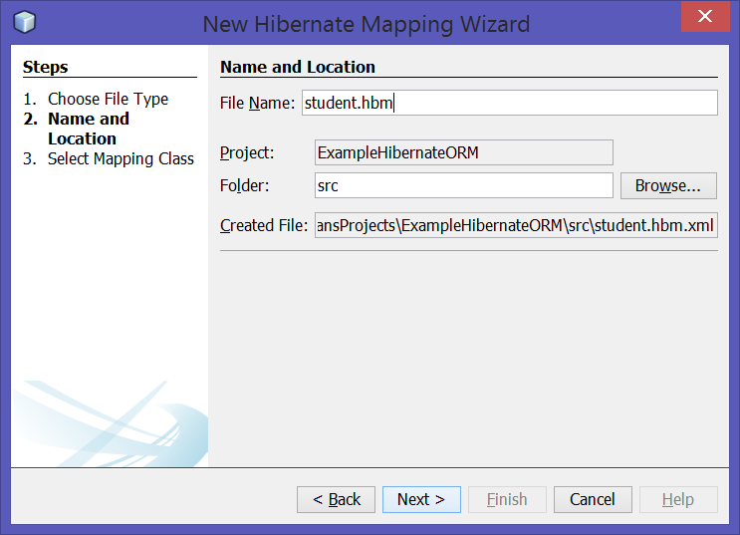
4. Create Hibernate Mapping
5
Rename the name
student.hbm
next
6

Slide 23
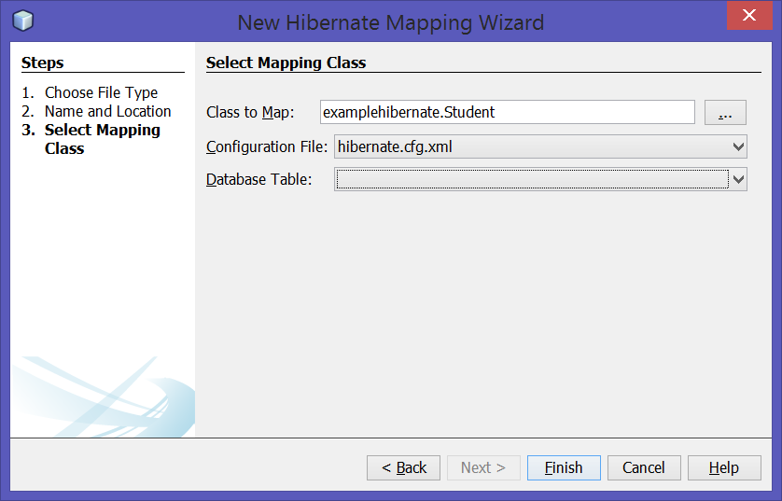
4. Create Hibernate Mapping
7
Select Student class in “Class to Map” column
Click “…” to browse
Finish
Do the same for class Teacher and Classroom
8

Slide 24
5. Modify the mapping .xml
Map object Student to table tbStudent
Map object Teacher to table tbTeacher
Map object Classroom to table tbClassroom
Map attribute teacher as a foreign key many-to-one to table tbteacher
Map attribute list student as foreign key one-to-many to table tbstudent

Slide 25
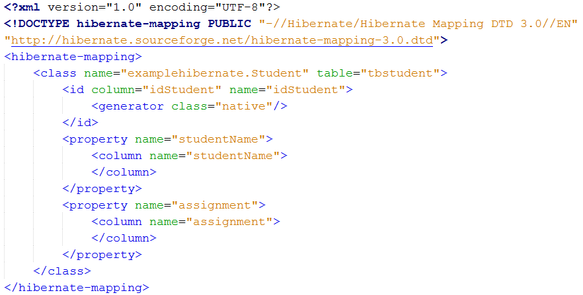
5a. student.hbm.xml

Slide 26
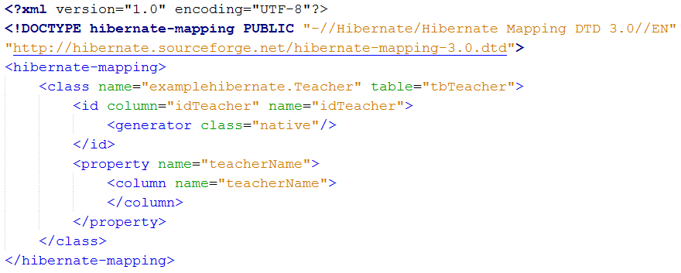
5b. teacher.hbm.xml

Slide 27
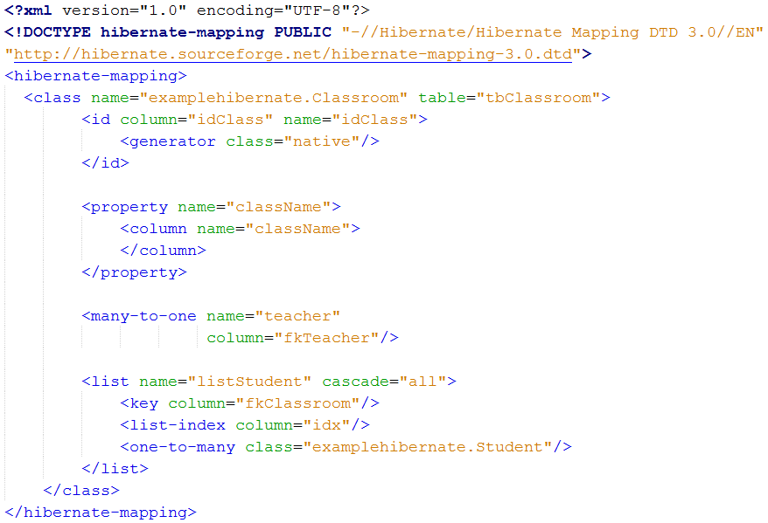
5c. classroom.hbm.xml

Slide 28
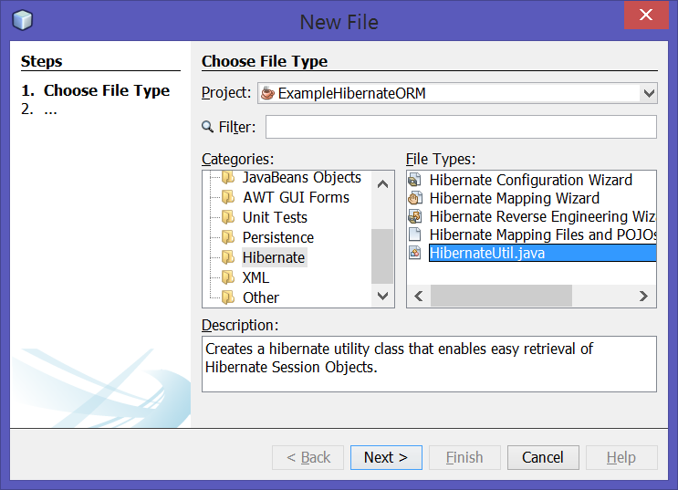
6. Create Hibernate Util class
File -> New File
Select categories : Hibernate
Select HibernateUtil.java
Next
3
2

Slide 29
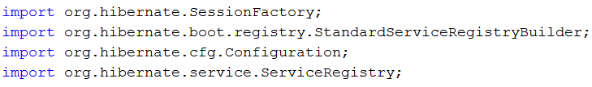
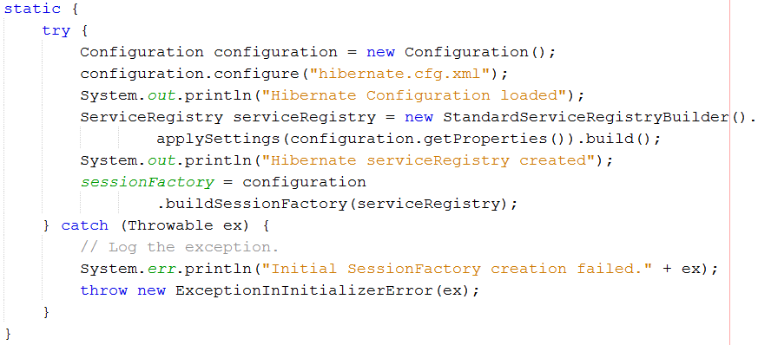
7. Modify the HibernateUtil.java

Slide 30
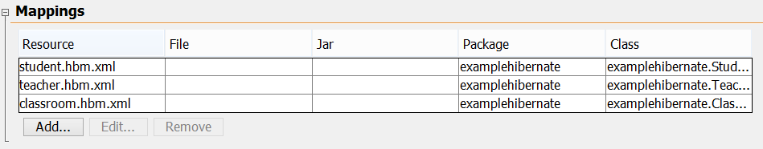
8. Modify the hibernate.cfg.xml
Make sure the mapping xml is properly listed
As you can see in source mode

Slide 31
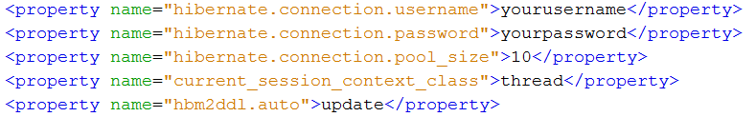
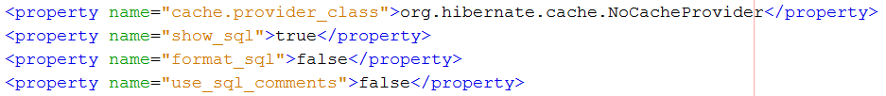
8. Modify the hibernate.cfg.xml
Add connection information to your database
Add your username and password for database
You might also add additional information

Slide 32
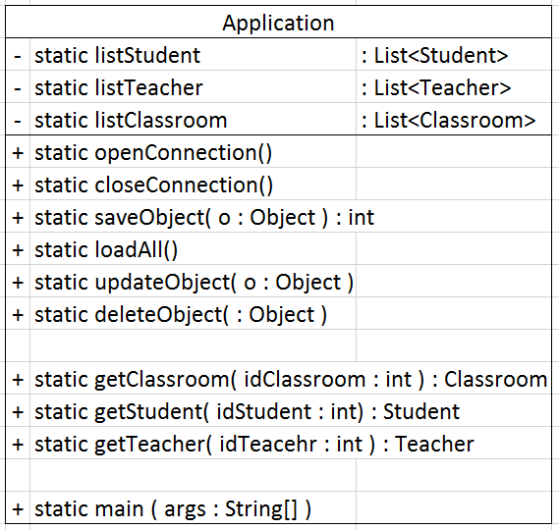
9. Application Class

Slide 33
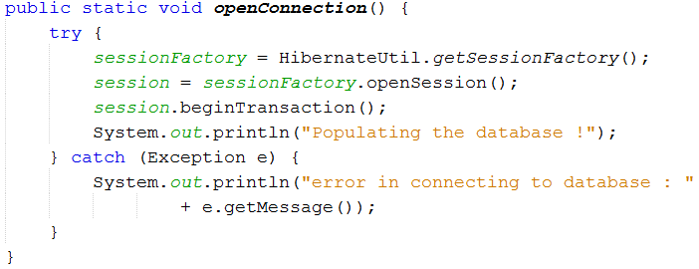
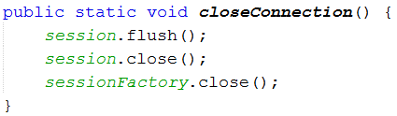
9. Application Class –
openConnection()
closeConnection()

Slide 34
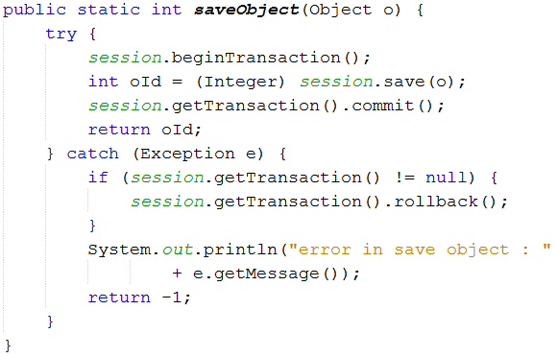
9. Application Class – saveObject( o : Object )

Slide 35
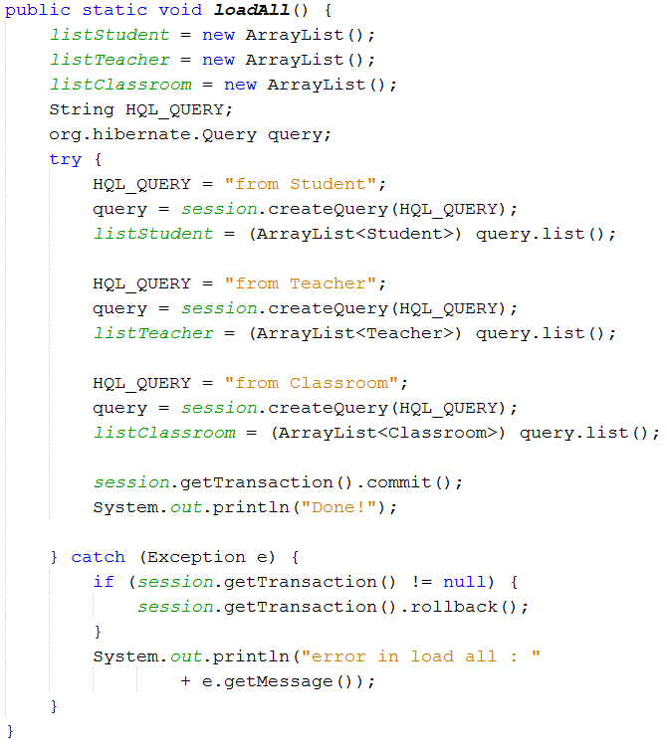
9. Application Class – loadAll()

Slide 36
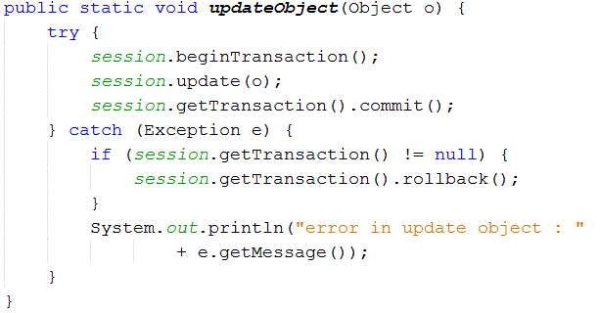
9. Application Class – updateObject( o : Object )

Slide 37
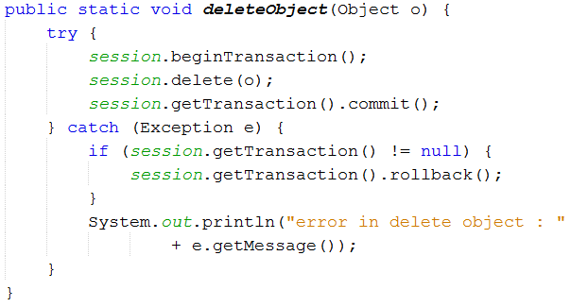
9. Application Class – deleteObject( o : Object )

Slide 38
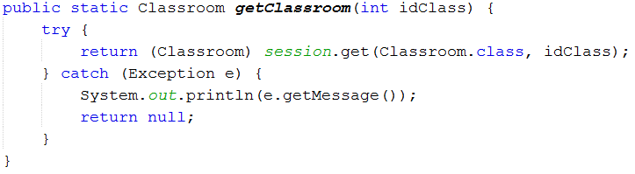
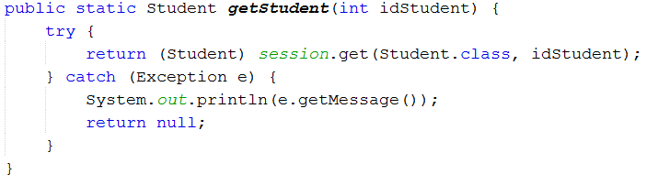
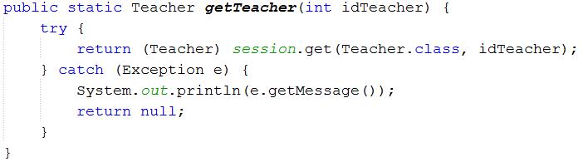
9. Application Class –
getClassroom()
getStudent()
getTeacher()

Slide 39
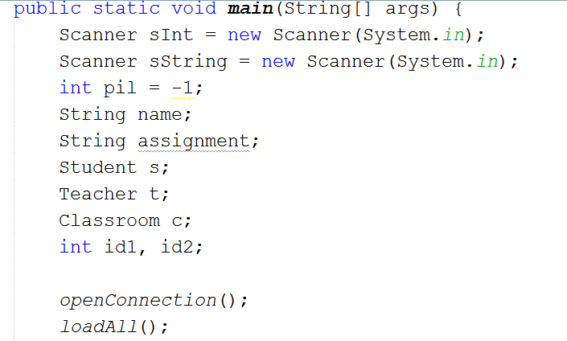
9. Application Class – main method

Slide 40
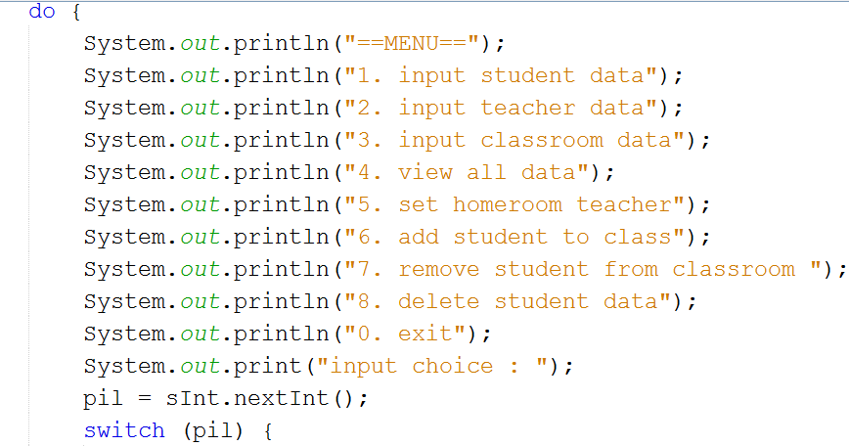
9. Application Class – main method (cont)

Slide 41
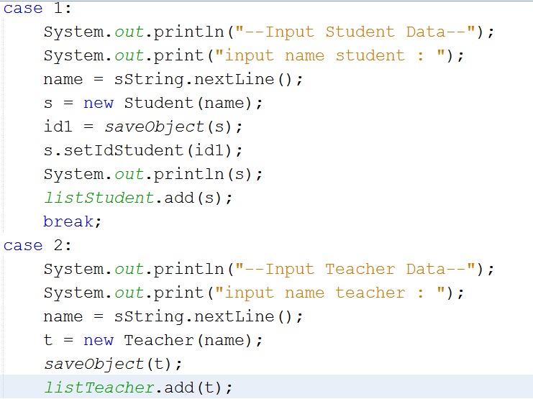
9. Application Class – main method (cont)

Slide 42
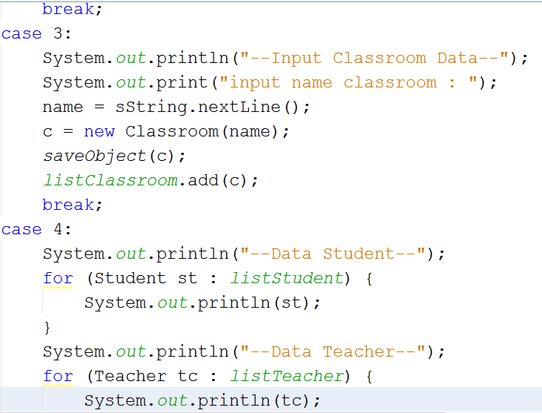
9. Application Class – main method (cont)

Slide 43
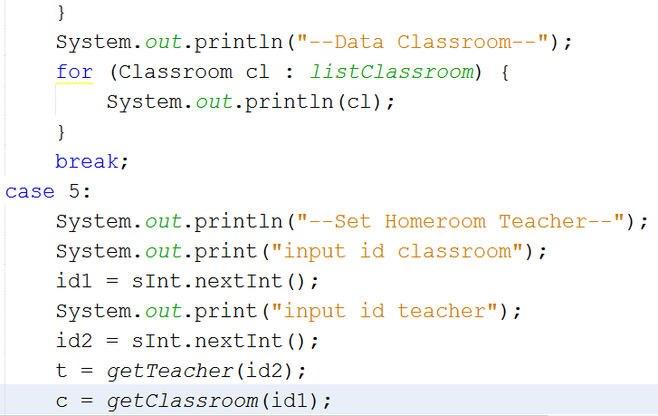
9. Application Class – main method (cont)

Slide 44
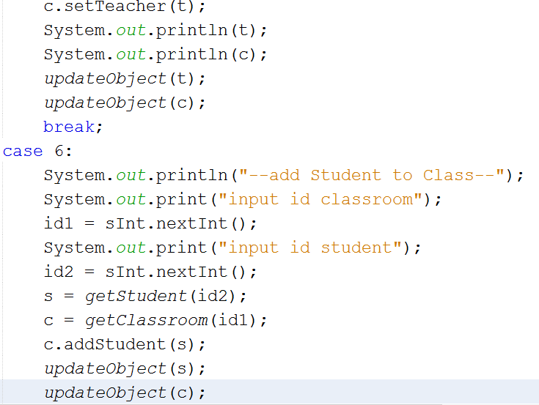
9. Application Class – main method (cont)

Slide 45
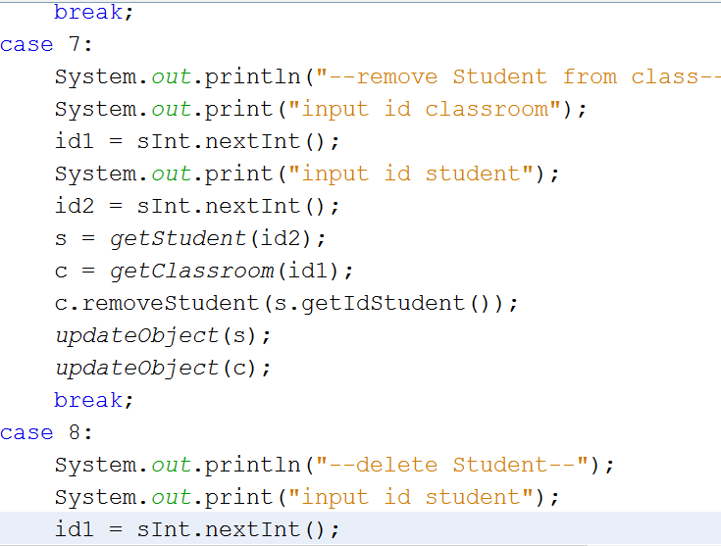
9. Application Class – main method (cont)

Slide 46
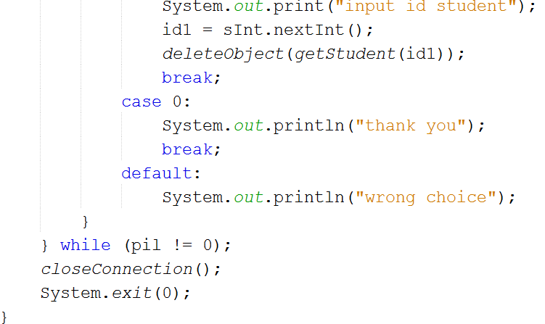
9. Application Class – main method (cont)

Slide 47
Good to read
http://hibernate.org/
http://docs.jboss.org/hibernate/orm/4.3/manual/en-US/html/
http://www.tutorialspoint.com/hibernate/

Slide 48

Credits
Music : Yonezawa Madoka - Oui! Ai Kotoba (Instrumental)

